Slide 1

IKEA Green+'s Sustainable Development Strategy in the Chinese Market
Group members: Grayson Eric Cecilia Judy
V Chavin Rin Jocelyn Piers

Slide 2

1.
Project Introduction
2.
IKEA's cooperation in the Chinese market
AFI Analysis: Business Environment Analysis
CONTENT
3.
4.
AFI-Formulation：Strategy formulation
AFI-Implementation：Strategy Implementation
5.
Summary: CSR and Sustainable Development Value
6.

Slide 3

Project Introduction

Slide 4
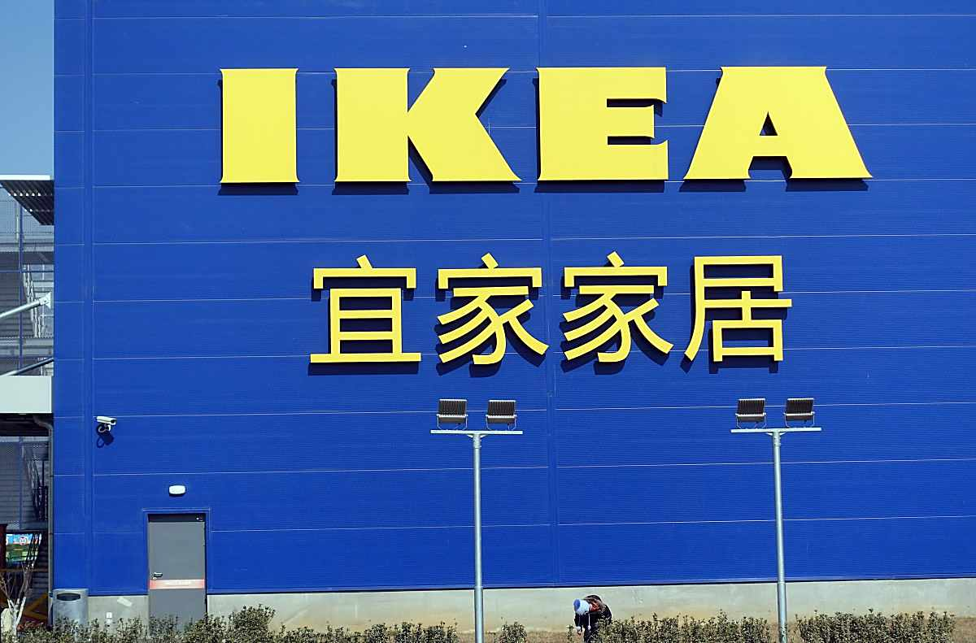
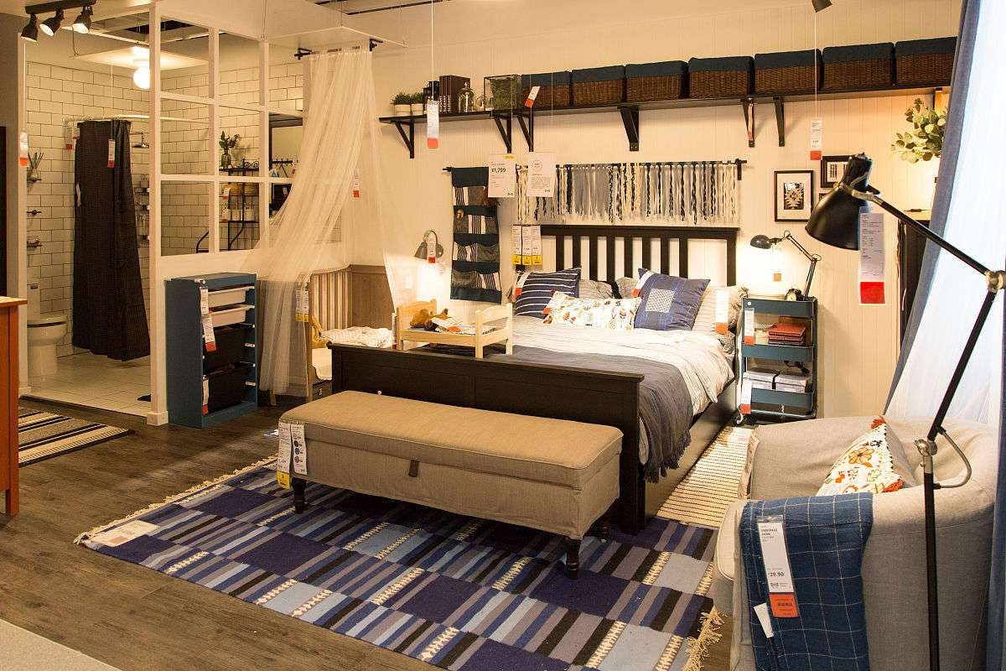

Project Introduction
Theme
IKEA Green's sustainable development strategy in the Chinese market aims to promote the sustainable development of the home industry through green design and environmentally friendly materials.
Analytical Method
We adopt the AFI framework to comprehensively cover all aspects of the project, from analyzing market trends to developing detailed plans, and finally implementing them.
Target
In the Chinese market, we are committed to promoting sustainable development and achieving a win-win situation for business and social value through the IKEA Green+strategy.

Slide 5
IKEA's Cooperation In The Chinese Market

Slide 6
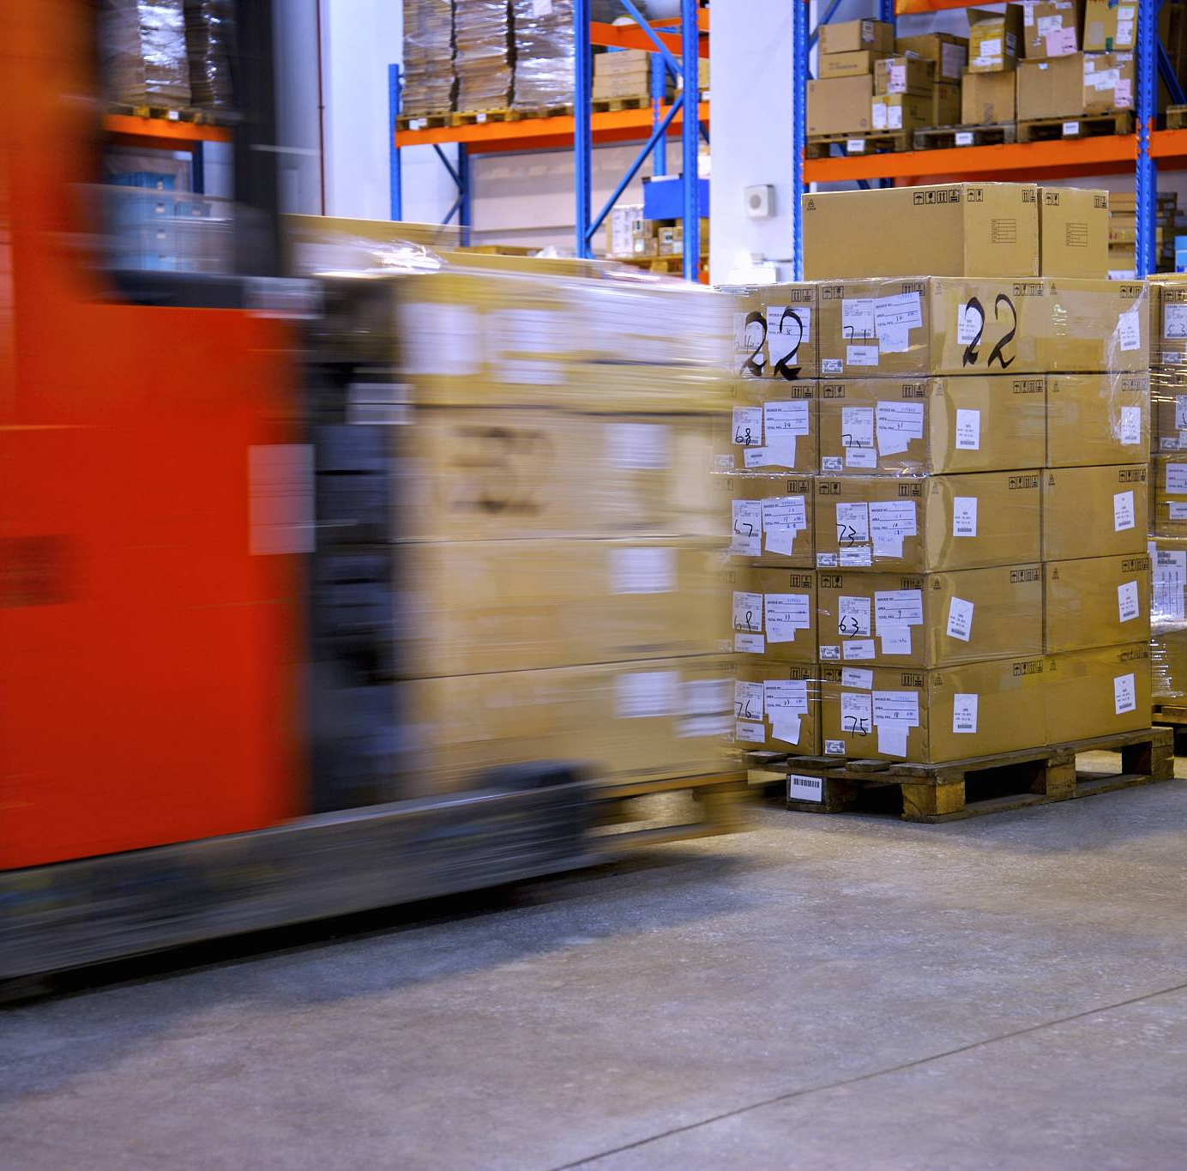
Collabrate With Local Logistics Companies
Outsourcing as the main approach+self built supplementary positions
IKEA adopts a logistics cooperation model mainly based on outsourcing in the Chinese market, while building key logistics nodes as supplements to ensure the efficiency and flexibility of the supply chain.
Collaboration Cases
Establish long-term cooperative relationships with local excellent logistics companies such as ESR Yishang to jointly create an efficient and environmentally friendly logistics system.
Coverage area
IKEA's logistics network in the Chinese market covers core regions, ensuring fast and accurate delivery of products to consumers.

Slide 7
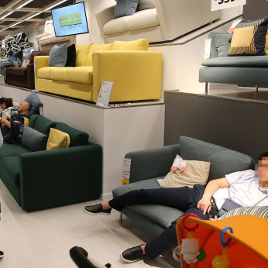
Joining The Local E-Commerce Platform
Join Tmall flagship store
IKEA officially entered the Tmall flagship store in 2020, further meeting the needs of Chinese consumers.
Product Category
IKEA's Tmall flagship store offers approximately 3800 products, including furniture, kitchen supplies, etc., to meet consumers' one-stop shopping needs.
Service Package
IKEA Tmall flagship store provides comprehensive services such as delivery, installation, and returns.

Slide 8
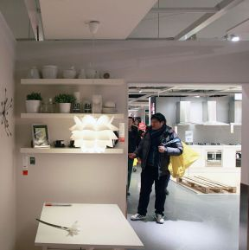
Offline Store Operation
Wholly owned holding, standardized operation
IKEA adopts a wholly-owned holding model for its offline stores in the Chinese market to ensure unified brand image and standardized operation.
Store Types
Including various types such as standard shopping malls, experience stores to meet the needs and market positioning of different consumers.
Case
IKEA in Fuzhou, which opened in 2020, has become a fashionable landmark in local home life.

Slide 9
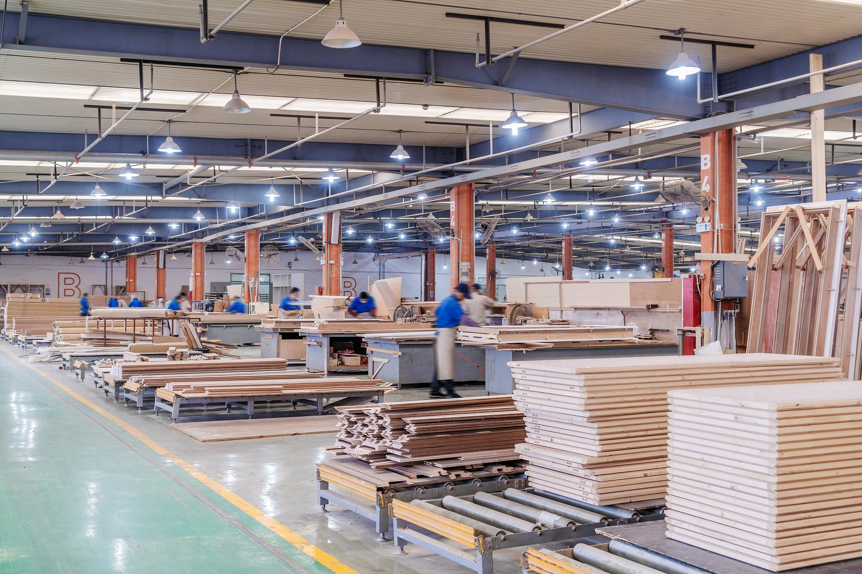
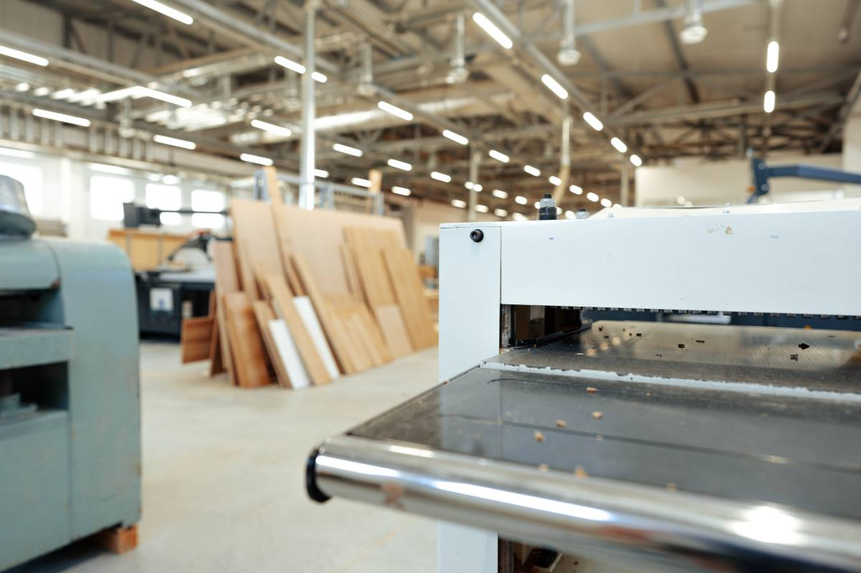

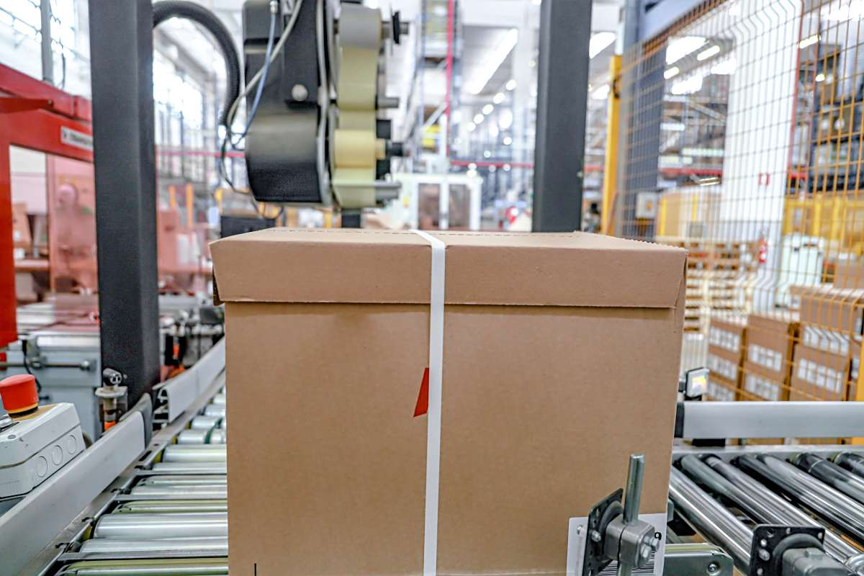
Product Authorization, Production
And Outsourcing
IKEA is responsible for design, research and development, and sales
IKEA focuses on product design, research and development, and sales to ensure that products comply with brand concepts and quality standards, leading market trends.
Domestic enterprise OEM production
Choose domestic enterprises with strong capabilities as OEM manufacturers, and ensure product brand consistency and excellent quality through strict quality monitoring and management systems.

Slide 10
AFI-Analysis：Business Environment Analysis

Slide 11
PESTEL Analysis
Political | Dual carbon policy, promotion of circular economy legislation, subsidies and tax incentives for green enterprises.
Economy | Economic growth slows down, consumers balance cost-effectiveness and green attributes, and the market size of green furniture continues to expand.
Social | Young consumers' awareness of environmental protection has awakened, and health and sustainability have become the core demands of furniture consumption.
Technological | Iterative development of environmentally friendly materials, popularization of green logistics, and application of blockchain traceability technology.
Environmental | The scarcity of resources is highlighted, the attention to climate change is increasing, and the public's demand for corporate environmental responsibility is rising.
Legal | Environmental regulations are becoming increasingly strict, garbage classification is being enforced, and green product certification standards are being standardized.

Slide 12
Industry Competition Porter’s Five Forces
Existing competitors
Potential entrants
Competitors such as MUJI have actively laid out green supply chains, putting pressure on IKEA Green.
With the increasing awareness of environmental protection, online environmental brands continue to emerge, posing a potential threat to IKEA Green's market share.
Bargaining power of suppliers
Substitute
Suppliers have moderate to high bargaining power, requiring IKEA Green to continuously innovate in supply chain management to reduce costs.
The existence of substitutes such as furniture rental requires IKEA Green to continuously innovate its products and services to meet the diverse needs of consumers.
Consumer bargaining power
Industry attractiveness and competitive pressure
Consumers have high bargaining power, requiring IKEA Green to maintain high product quality while provide competitive prices.
The attractiveness of the Chinese furniture industry is moderate, and the competitive pressure mainly focuses on differentiation and cost control.

Slide 13
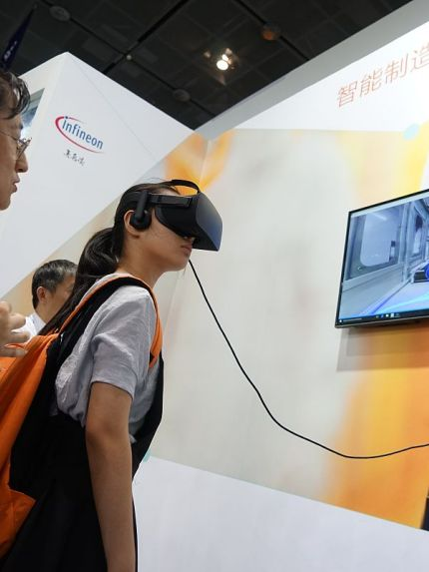
Internal Environment： VRIO Framework
01
Global Supply Chain and Economies of Scale
IKEA Green has global supply chain and economies of scale advantages, providing strong support for its sustainable development in the Chinese market.
02
Store Experience and Design
Store experience and design are the advantages of IKEA Green+, attracting consumers through unique scenario-based experiences and enhancing brand awareness.
03
Insufficient Response Speed
Compared with competitors, IKEA Green+ is insufficient in responding to market changes and needs to speed up decision-making to adapt to the rapidly changing market environment.

Slide 14

SWOT Analysis
Strengths
Opportunities
IKEA Green+ has strengths such as a sustainable brand reputation and high transformation costs in the Chinese market.
IKEA Green+’s Opportunities include policy dividends, local brand competition, and green consumption upgrading.
Weaknesses
Threats
IKEA Green+ has weaknesses including lagging technological adaptation and room for optimizing store energy consumption.
IKEA Green’s threats include potential entrants, technological iteration, and rising compliance costs.

Slide 15
AFI-Formulation：Strategy Formulation

Slide 16
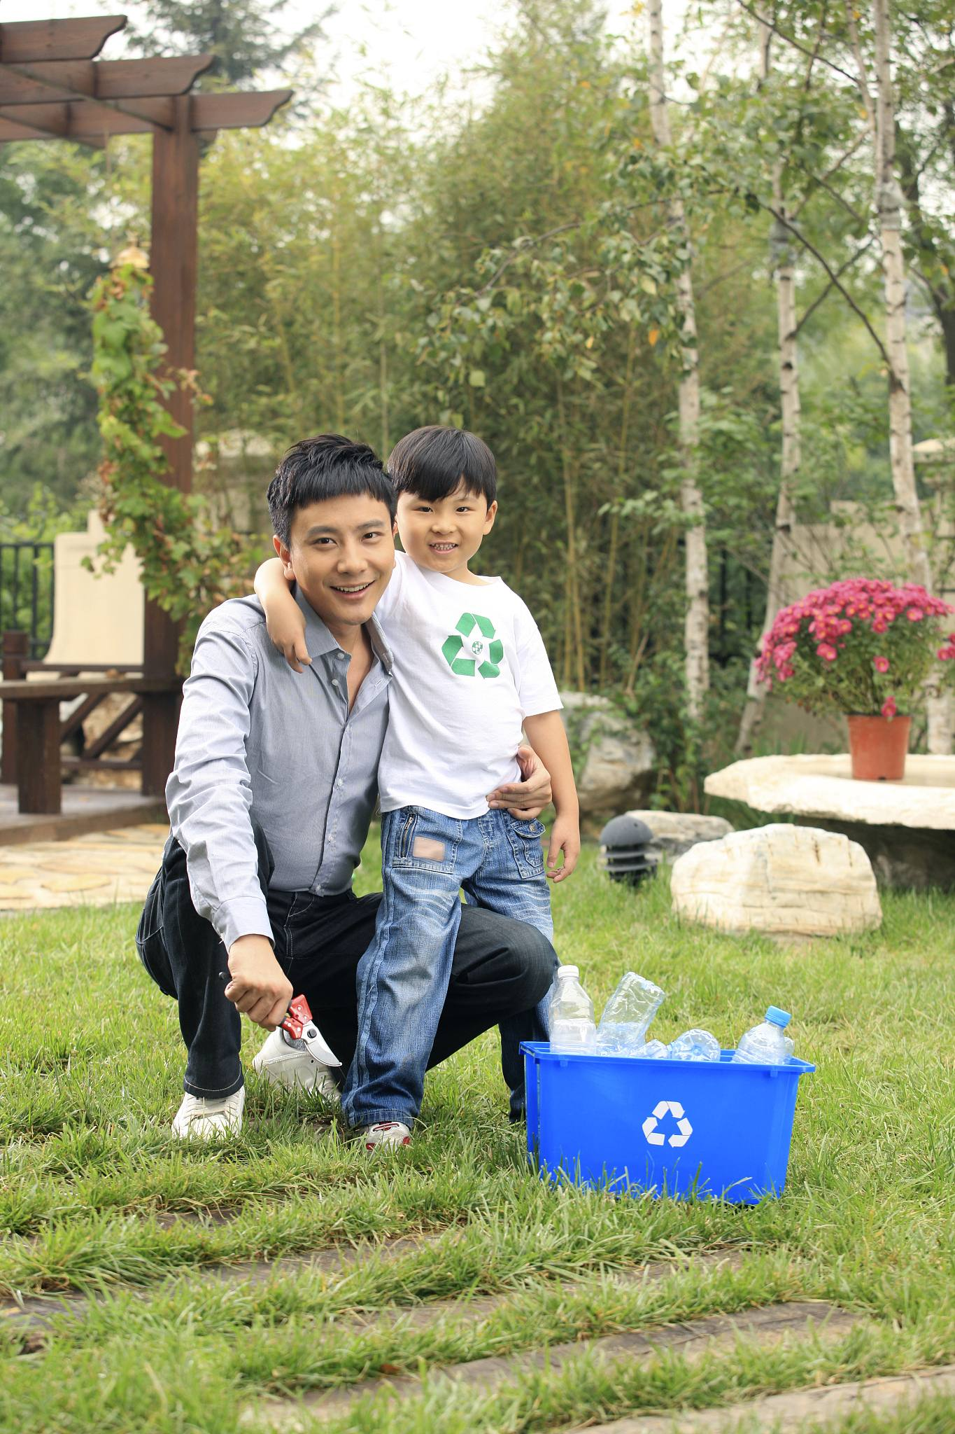

Strategic Intent
Mission
Committed to creating more environmentally friendly, healthy, and affordable daily life solutions for Chinese people, making green living accessible to everyone.
Vision
Aim to become China's most trusted leader in environmentally friendly home life, lead the new trend of green living, and create a better living environment for the public.
Strategic Goals
The Green+ series accounts for 25% of sales in 2026, 35% in 2028. All products use renewable/recycled materials by 2030. Stores achieve carbon neutrality by 2030.

Slide 17
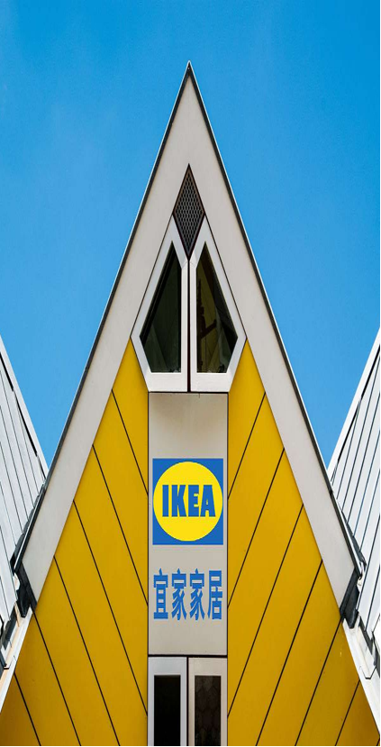
Green Product Innovation - Materials and Design
Promotion of Environmentally Friendly Materials
Modular Design for Extended Lifespan
Focus on promoting renewable wood, recycled plastic and other environmentally friendly materials.
Implement modular design to support separate replacement of product components, effectively extending product life cycle.
China-Specific Moisture-Proof Panels
Green Packaging to Reduce Loss
Develop moisture-proof, durable and environmentally friendly panels for China's humid climate.
Reduce redundant packaging, adopt green packaging, reduce loss in the logistics link.
Blockchain Technology Traceability
Easy-to-Disassemble and Recyclable Furniture
Consumers can scan codes to know the source and environmental indicators, enhancing product transparency and trust.
Launch easy-to-disassemble and recyclable panel furniture to avoid the one-time use problem of furniture.

Slide 18
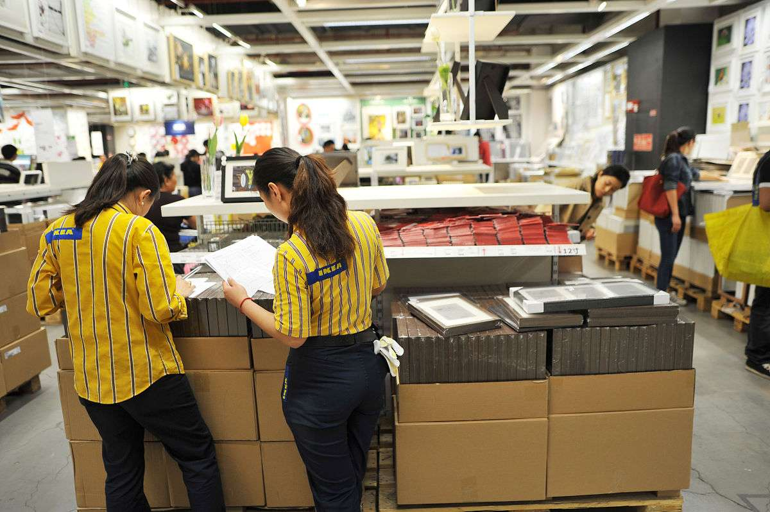
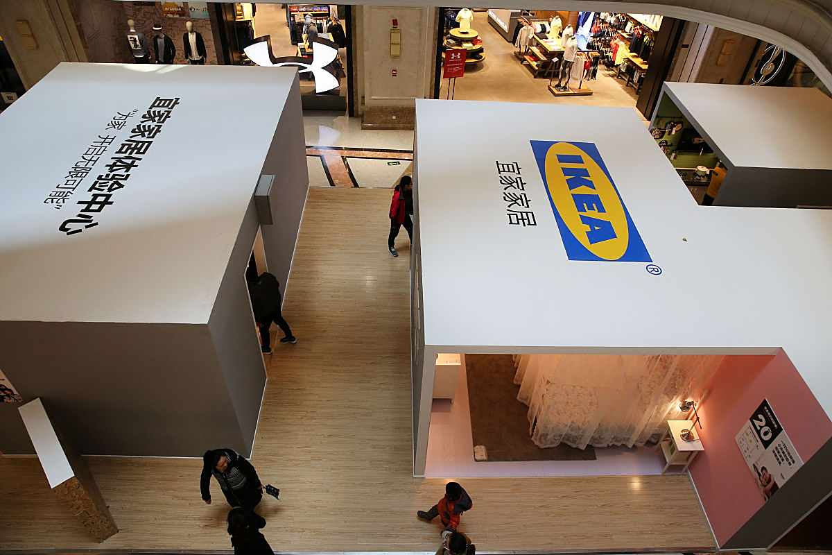
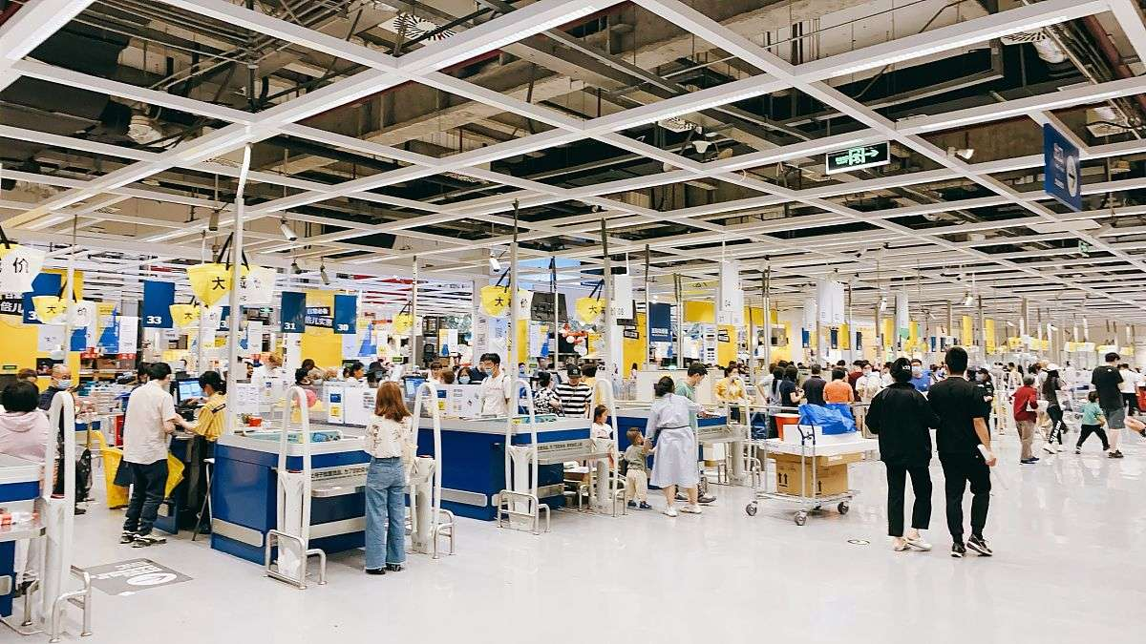
Cost Control Mechanism
Large-Scale Procurement to Reduce Costs
Reduce raw material costs through large-scale procurement of environmentally friendly materials, such as signing long-term agreements with local Chinese PCR plastic enterprises.
Optimize Production Processes to Control Costs
Optimize production processes such as integrated injection molding to reduce waste, control the additional cost of environmentally friendly materials within 5%.

Slide 19
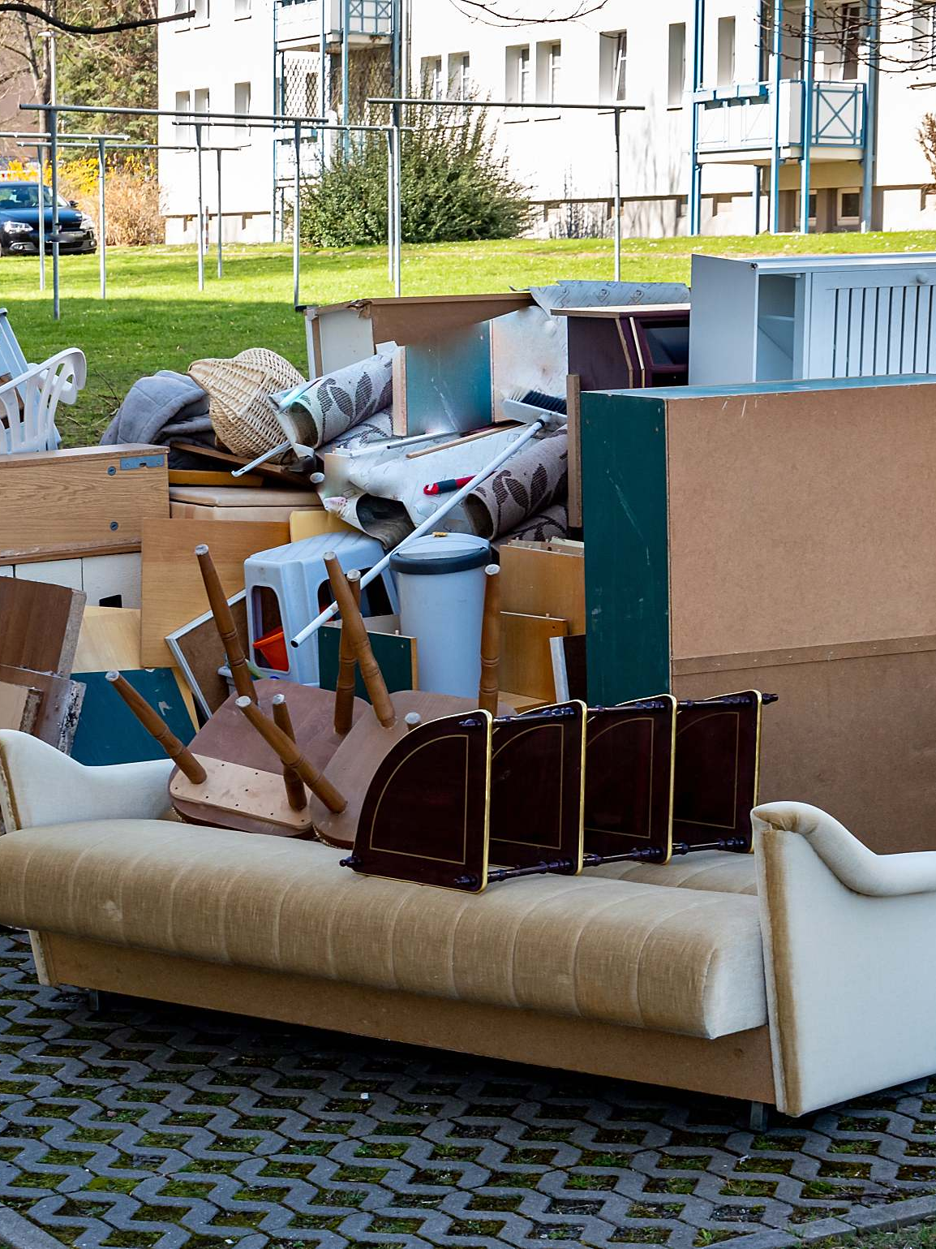
Circular Economy Business Model
Short-Term Rental Packages
Home Recycling +Discount Vouchers
Launch the "home recycling + discount voucher" service for IKEA's own brand furniture. After recycling, classify and process according to the condition.
Focus on young tenants and corporate clients, launch "short-term rental packages" - for example, provide 1-2 year furniture rental services for college students during graduation season, with monthly rent as low as 150 yuan.
IKEA Second-Hand Zone
IKEA sells newer recycled furniture at a discount, dismantling damaged items into renewable materials.
Reduce Environmental Pressure
IKEA will recycle and dispose of the furniture after the rental period; provide office furniture rental for enterprises, supporting renewal or replacement.
Expansion of Trade-In Business
By 2025, realize the coverage of trade-in business in all standard stores nationwide, expanding the recycled categories from core furniture to small home items.

Slide 20
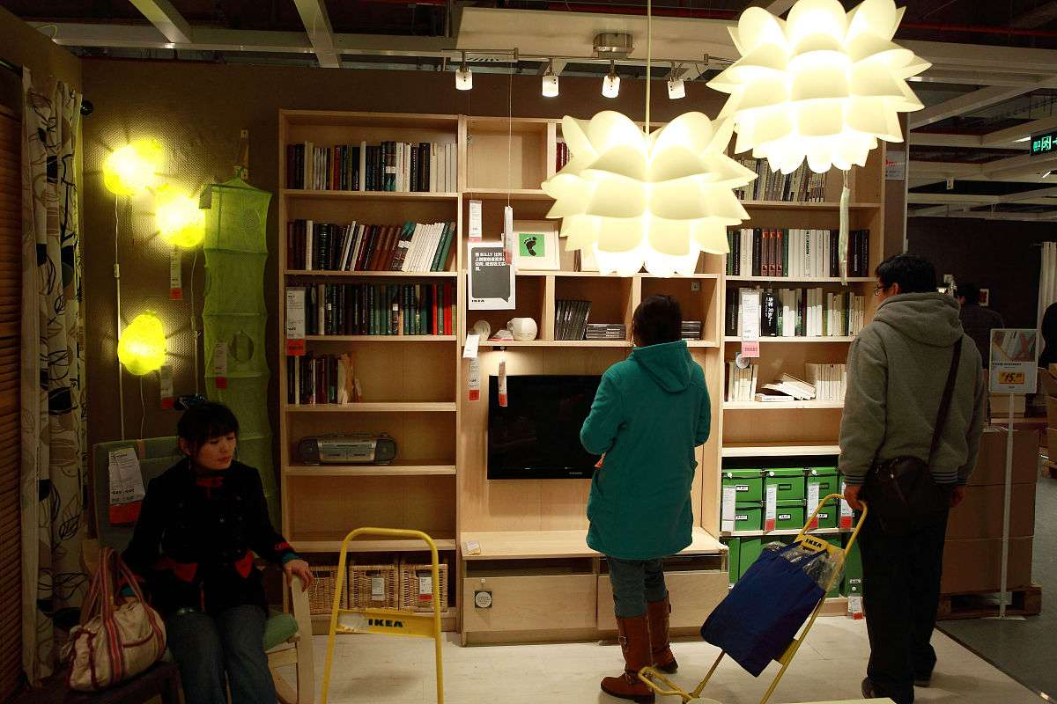
Construction Of Consumer Participation Scenarios
Environmental Workshops and Sustainable Actions
Set up "environmental workshops" in stores, regularly hold experience activities such as "old furniture transformation" , inviting consumers to participate in sustainable actions.
Environmental Points System
Launch an "environmental points system" online. Consumers can accumulate points by participating in recycling and purchasing environmental products, which can be exchanged for environmental peripherals or shopping discounts to strengthen user stickiness.

Slide 21

Green Transformation Of Local Suppliers
Green Supplier Rating System
Establish a "green supplier rating system", incorporate carbon emission intensity and the proportion of environmentally friendly materials used into cooperation assessment indicators.
Support for Suppliers' Green Transformation
Cooperate with Chinese environmental protection institutions to provide free carbon emission reduction consulting services for small and medium-sized suppliers, helping them upgrade production equipment.
Prioritize Procurement of Local Renewable Materials
Prioritize cooperation with local Chinese renewable material enterprises, reducing carbon emissions from cross-border transportation.

Slide 22
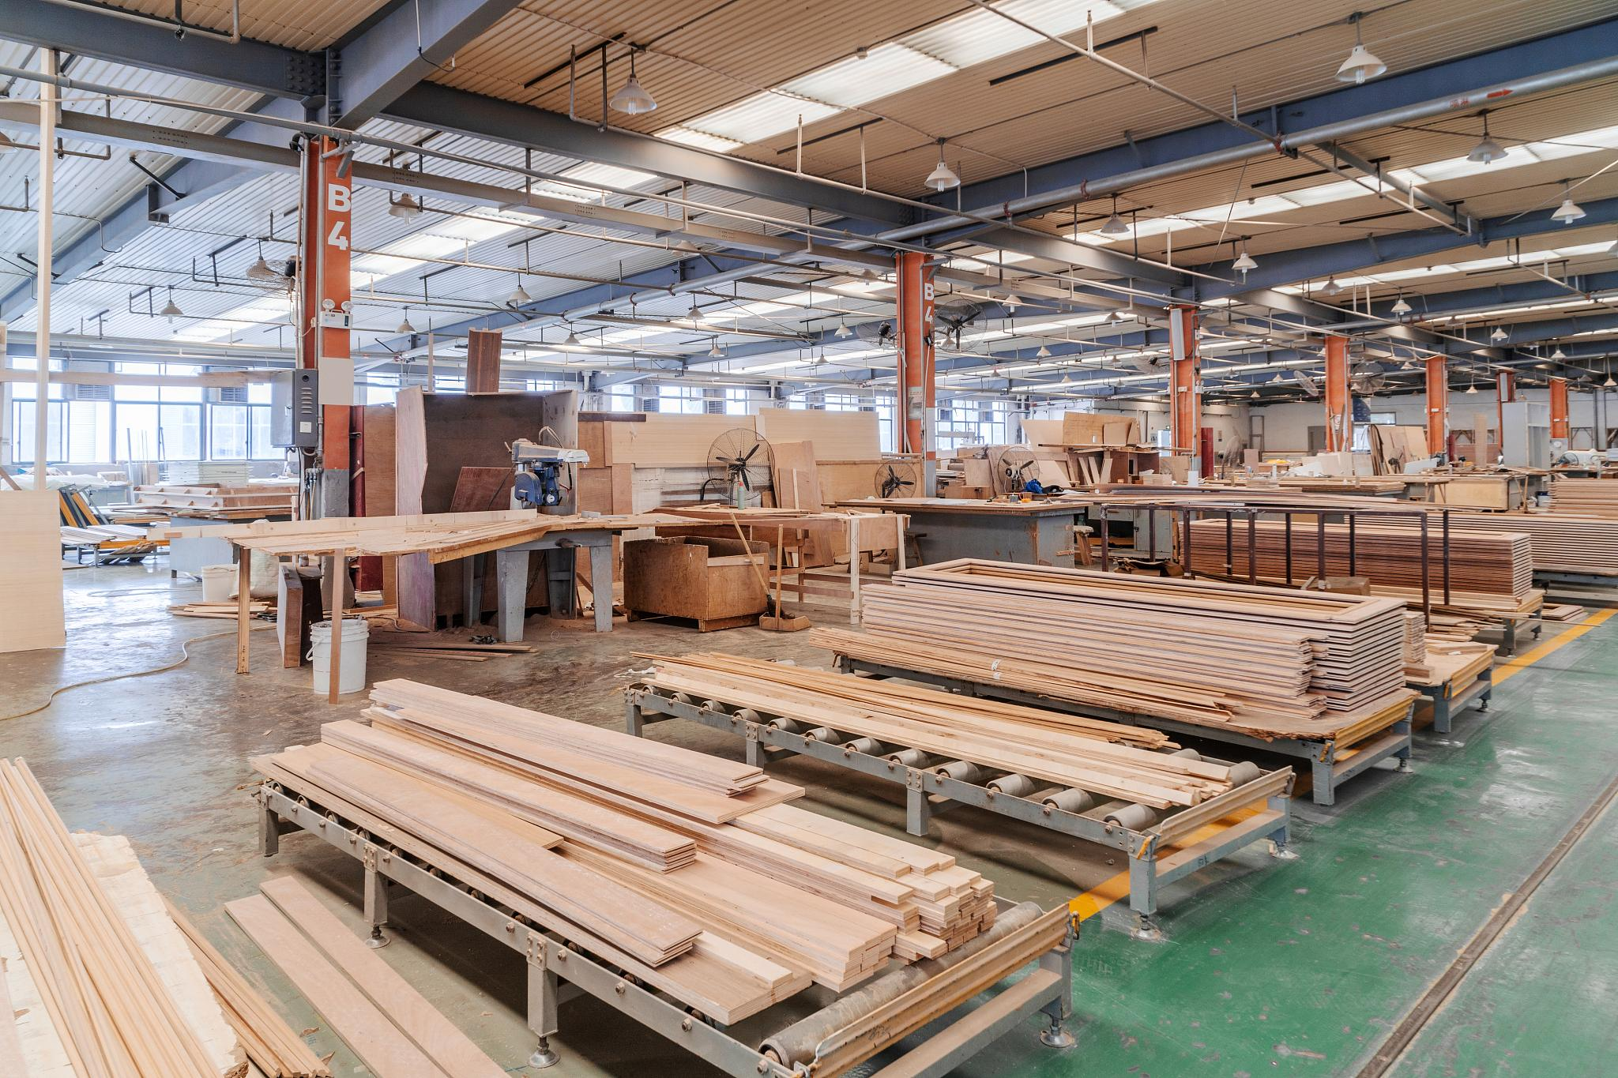
Energy-Saving Transformation Of Production Line And Stores
Promotion of Low-Carbon Production Processes
Promote local Chinese OEM factories to introduce "low-carbon production processes", such as replacing traditional paint with water-based paint to reduce volatile organic compound emissions.
Comprehensive Energy-Saving Transformation of Stores
Fully implement energy-saving measures in stores - adopt LED intelligent lighting and water circulation air conditioning systems. Achieve a 20% reduction in operating energy consumption of all stores compared with 2023 by 2026, and rely entirely on renewable energy for power supply by 2030.

Slide 23

Construction of Green Logistics Network
New Energy for Long-Distance Transportation
Adopt the "outsourcing + self-built" model to optimize logistics carbon emissions - cooperate with local logistics enterprises.
Optimization of Short-Distance Distribution
Cooperate with community stations for short-distance distribution, implement the "centralized delivery + self-pickup" model to reduce the empty driving rate of terminal distribution; promote intelligent temperature control systems and photovoltaic power generation in the warehousing link.

Slide 24
AFI-Implementation: Strategy Implementation

Slide 25
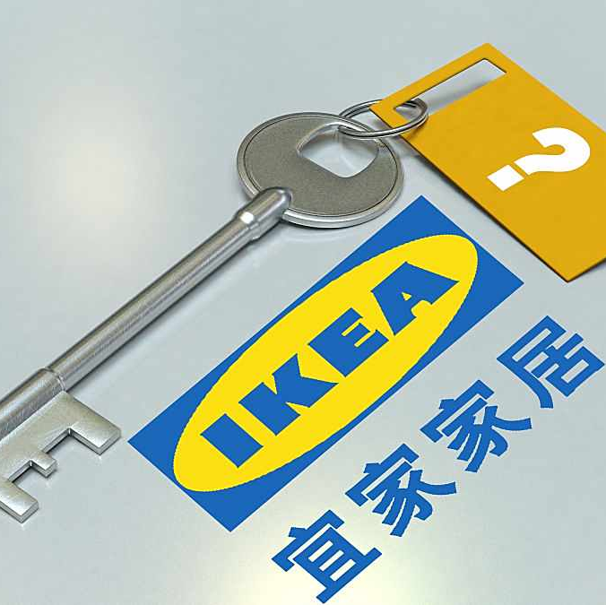
Organizational Structure And Resource Allocation
Organization
Establish a Sustainability Committee, appoint a sustainability management team, clarify responsibilities, and strengthen decision-making and execution.
Human Resources
Recruit material experts, provide employee training (annual training > 40 hours), and improve the team's professionalism and green management capabilities.
Financial Resources
Allocate special investments (such as 1 billion euros for recycling infrastructure) to ensure financial support for strategy implementation.

Slide 26
Measurement And Feedback System
Dimension
Financial
Customer
Internal Processes
Learning and Growth
KPI
Green+ sales profit margin: Measure the sales performance of Green+ series products, focusing on the growth of their sales volume and profit margin.
Brand sustainability image score: Evaluate the brand's sustainability image, collect and analyze customer feedback scores to understand market acceptance.Green member count and recycled material ratio: Track the number of green members, set recycled material ratio targets, and promote recycling and environmental actions.
Carbon emissions and employee training coverage: Record and reduce carbon emissions, while ensuring employee training coverage and learning and growth rates to improve team capabilities.
Number of green patents: Encourage innovation, record and publish the number of green patents to demonstrate technological innovation capabilities in the environmental protection field.
客户KPI

Slide 27
Change And Risk Management
01
02
03
04
05
Phased Investment and Cost Overrun: Adopt a phased investment strategy, strictly control costs, prevent overrun, and ensure the smooth progress of the project.
Large-Scale Procurement and Long-Term Cooperation: Establish long-term cooperative relationships with multiple suppliers to achieve large-scale procurement, reduce costs, and ensure supply stability.
Diversification to Address Supply Chain Fluctuations: Select diversified suppliers to cope with risks brought by fluctuations in a single supply chain and ensure the unimpeded implementation of the strategy.
Improve Market Acceptance through Experiential Marketing: Enhance market acceptance through experiential marketing, deeply understand customer needs, and optimize products and services.
Affordable Pricing: Adopt a people-friendly price positioning to attract mass consumers, ensuring that products and services can be widely popularized to achieve sustainable development goals.

Slide 28
Summary: CSR and Sustainable
Development Value

Slide 29
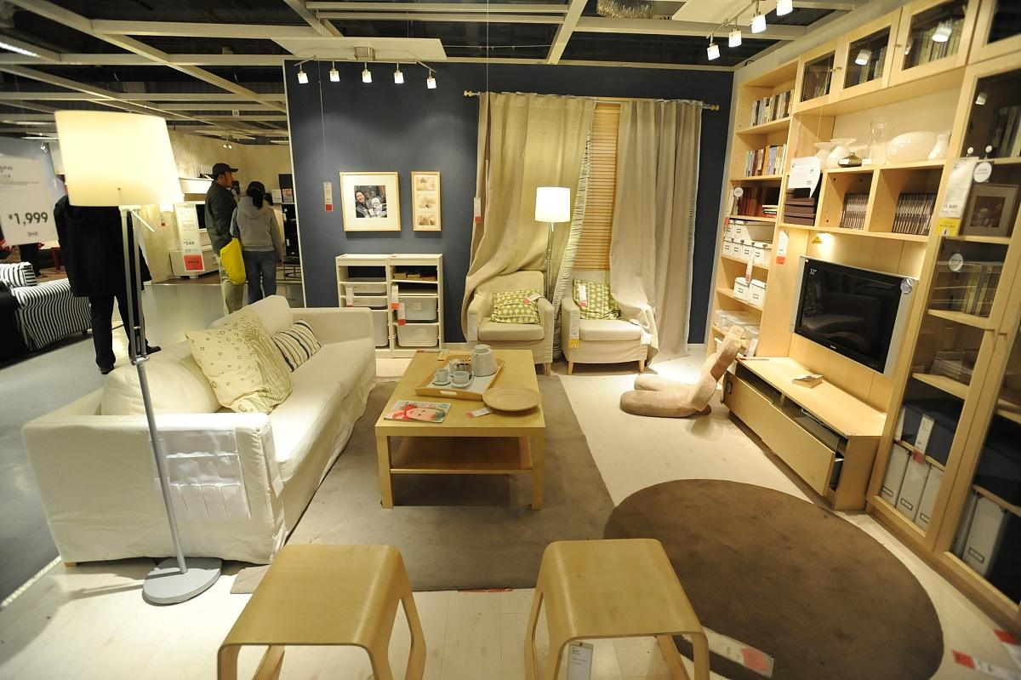
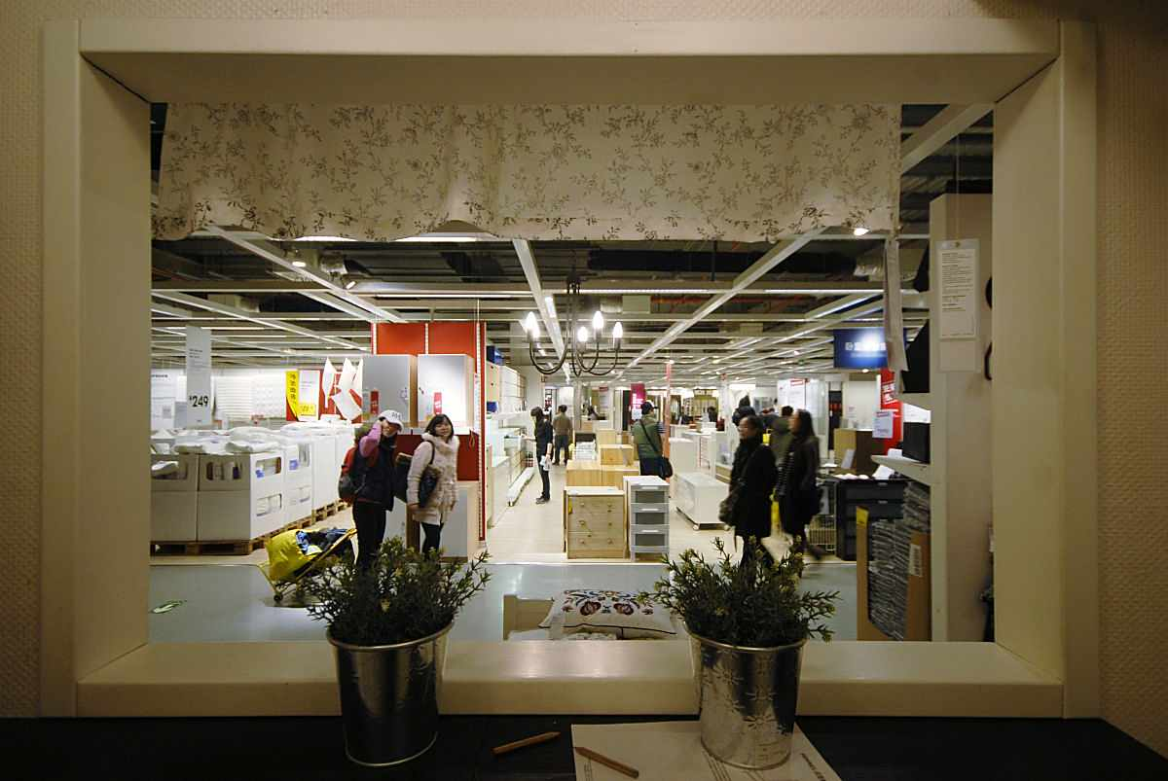
Summary: CSR And Sustainable Developmet Value
Fair Supply Chain and Social Value
IKEA builds a stable supply chain in the Chinese market through fair trade and sustainable development practices, actively giving back to the community, supporting employee development, and achieving a harmonious unity of social value and business success.
Circular Economy, Carbon Environment, and Brand Reputation
Emphasize product recycling and carbon footprint reduction, promote green lifestyles, enhance brand social image, strengthen consumer loyalty, and lay a solid foundation for business expansion.

Slide 30
THANK YOU FOR LISTENING

